Slide 1
SM Configuration Migration in the Cloud
How to migrate changes into Production

Slide 2
Purpose

Slide 3
Purpose of the webinar is to provide process steps and best practice recommendations of how to work with Ivanti to successfully migrate new content from non-production to production
Intended audience are trained Administrators of the Ivanti Service Manager solution (previously known as HEAT Service Management)
Notes:
Changelog helps identify dependencies to build test cases
Process

Slide 4
I’ve gone live….now what?

Slide 5
Benefits of Using Packages
Reduces risk to Production
Better management of changes to Production
Ability to Push multiple projects in a package
Allows for Parallel and Mid-Stream Development

Slide 6
Process Overview

Slide 7
Before you begin
Refresh Staging (STG) at start of new dev cycle
Keep a change log
Keep in mind package naming
Push packages through our Self-Service or on your own
Try to keep packages under 40MB
Using the HEAT Development Project – Help File
Notes:
Changelog helps identify dependencies to build test cases

Slide 8
Ivanti Service Manager Cloud
Production Landscape
PRODUCTION TENANT
Non-Production Landscape
STAGING TENANT
UAT TENANT

Slide 9
Package Migration: The Process
Build your package
Test your package
Migrate package to Production
Create a project STG | Push Package to UAT | Push Package to PRD
Record Transactions | Test and validate changes
Assign Project to Package

Slide 10
Creating Projects
In the Build menu select HEAT Development Project
Start a new record, complete and save
After refresh the new project is now available for selection

Slide 11
Creating and Building Packages
Under Build go to HEAT Development Package -> Packages
Click New Record, complete and save
Incremental package
Assign transactions to a package Project Workspace -> Transaction Sets
Select transaction sets you would like and assign to package
Select package name in drop down

Slide 12
Importing Packages to UAT
Can be imported by us or on your own
Refresh/Provision UAT
From our self-service submit Service Request for package push
Self-import (Recommended)
  Log into UAT -> Configure Application -> Packages Workspace
  Import Package -> Browse and select package
  Validate – You can validate the data and review any errors
  Validate and apply if no errors – Recommended
  Apply without validation – highest risk
Test…Test…Test
  Error/Failure – Go back to STG and test/rebuild package
  Success – Package is ready to import to PRD

Slide 13
Importing Packages into Production
Recommended to be completed through service request
  We take a backup prior to import with option to roll-back
  Schedule time a time for import, confirmation within 6 hours
  OPS will send a schedule a reminder and communicate when completed – TTR
  Operations schedules at least a 2 hour maintenance window
  Don’t forget to close the package before requesting a PRD push
Not recommended - self-import
  Option available for low/medium risk imports
  No backup prior to import, no ability to roll-back
Failures/Bugs
  Option to rollback to backup taken prior to package commit
  Go back to STG/UAT, test and troubleshoot

Slide 14
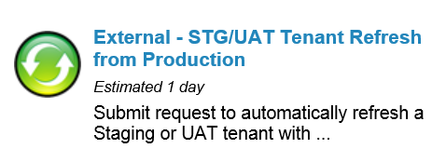
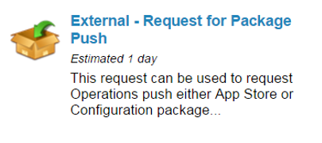
Working with Service Requests
Refreshing STG/UAT
  Automatic refresh – first come first serve
  Time dependent on DB Size
Package Pushes STG/PRD
  Available Monday – Friday 24x5 for all GEOs
  Pushes to PRD available outside business hours
  Same request to push STG > UAT and STG > PRD
    A repush requires a new request
  PRD tenant in read-only mode, recommended for users to log out
  OPS confirms scheduled time within 6 calendar hours with calendar reminder
  Email sent 5 minutes prior to starting and a confirmation email when completed

Slide 15
Package troubleshooting tips
Be sure to attach only your change transaction sets to the package
Do not make the changes in the target tenant prior to package push

Slide 16
Global Support Services
Log an Incident with support:
  https://success.ivanti.com/customers
How to Contact Support
https://community.ivanti.com/community/other/contact-support

Slide 17
Demo

Slide 18
Thank you

